Slide 1


JAVA INTERVIEW BOOTCAMP
Lecture 5

Slide 2

Today’s Agenda
Command Line Arguments
Retrieving Command Line Arguments
Some Points About args
Tricky Interview Questions

Slide 3
Command Line Arguments
If any input value is passed through the command prompt at the time of running of the program , it is known as command line argument .
Special Points:
There is no restriction on the number of java command line arguments.
Information is passed as String objects.
They are captured into the String args of our main method

Slide 4
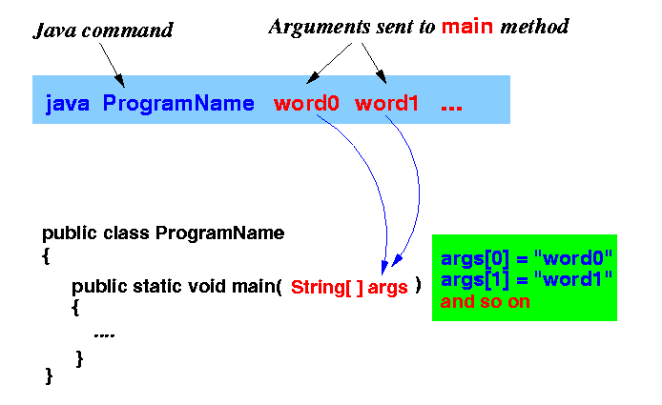
Command Line Arguments

Slide 5
Command Line Arguments
IMPORTANT INTERVIEW QUESTION
Is args an array?
Answer:
No
What exactly is args ?
Answer:
It is a reference to an array of references to String objects

Slide 6
Command Line Arguments
IMPORTANT INTERVIEW QUESTION
Can we give any other name to args?
Answer:
Yes
What is the difference between following 2 statements ?
Java Test hello world
Java Test “hello World”
Answer:
In the first case “hello” will go in args[0] and “world” in args[1], while in the second case entire “hello world” will go in args[0]

Slide 7
Retrieving Command Line Arg
Since args receives an array as its value , we can iterate over args and access each of these values:
public class Echo {
public static void main (String[] args) {
for (String s: args) {
System.out.println(s);
}
}
}
OUTPUT:
java Echo Sharma computer Academy
Sharma
Computer
Academy

Slide 8
Guess The Output
public class Add { public static void main(String[] args) { int sum = 0; for (int i = 0; i < args.length; i++) { sum = sum + args[i]; } System.out.println("The sum of the arguments passed is " + sum); } }
Output:
Incompatible Types: String cannot be converted to int

Slide 9
Passing Numeric Argument
If an application needs to support a numeric command-line argument, it must convert a String argument that represents a number, such as "34", to a numeric value .
This is done using the method parseXXX() of corresponding Wrapper class.
For example , parseInt( ), parseLong( ), parseFloat(),parseDouble( ) etc

Slide 10
Passing Numeric Argument
public class Add { public static void main(String[] args) { int sum = 0; for (int i = 0; i < args.length; i++) { sum = sum + Integer.parseInt(args[i]); } System.out.println("The sum of the arguments passed is " + sum); } }

Slide 11
Tricky Interview Questions
Which of the following method signatures is a valid declaration of an entry point in a Java application?
A. public void main(String[] args)
B. public static void main()
C. private static void start(String[] mydata)
D. public static final void main(String[] mydata)
Correct Answer:
D

Slide 12
Tricky Interview Questions
What is the result of compiling and executing the following class?
public class ParkRanger {
int birds = 10;
public static void main(String[] data) {
int trees = 5;
System.out.print(trees+birds);
}
}
A. It does not compile.
B. It compiles but throws an exception at runtime.
C. It compiles and outputs 5.
D. It compiles and outputs 15.
Correct Answer:
A

Slide 13
Tricky Interview Questions
Given the following class definition, which command will cause the application to output the message White-tailed?
public class Deer {
public static void main(String[ ] params) {
System.out.print(params[2]); } }
A. Java Deer deer 5 "White-tailed deer"
B. Java Deer "White-tailed deer" deer 3
C. Java Deer Red deer White-tailed deer
D. Java Deer My "deer White-tailed"
Correct Answer:
C

Slide 14
Tricky Interview Questions
class JavaGuru {
public static void main(String[] args) {
System.out.println(args[1]+":"+ args[2]+":"+ args[3]); } }
What is the output of the above code , if it is executed using the following
command?
java JavaGuru one two three four
A. one:two:three
B. JavaGuru:one:two
C. java:JavaGuru:one
D. two:three:four
Correct Answer:
D

Slide 15
Tricky Interview Questions
Which of the following are legal entry point methods that can be run from the command line? (Choose all that apply)
A. private static void main(String[] args)
B. public static final main(String[] args)
C. public void main(String[] args)
D. public static void test(String[] args)
E. public static void main(String[] args)
F. public static main(String[] args)
G. None of the above.
Correct Answer:
E

Slide 16
Tricky Interview Questions
Which of the following are true? (Choose all that apply)
public class Bunny { public static void main(String[] args) { Bunny bun = new Bunny(); } }
A. Bunny is a class.
B. bun is a class.
C. main is a class.
D. Bunny is a reference to an object.
E. bun is a reference to an object.
F. main is a reference to an object.
G. None of the above.
Correct Answer:
A,E

Slide 17
Tricky Interview Questions
What does the following code output?
1: public class Salmon {
2: int count;
3: public void Salmon() {
4: count = 4;
5: }
6: public static void main(String[] args) {
7: Salmon s = new Salmon();
8: System.out.println(s.count);
9: } }
A. 0
B. 4
C. Compilation fails on line 3.
D. Compilation fails on line 4.
E. Compilation fails on line 7.
F.Compilation fails on line 8.
ANSWER:
A

